Slide 1
Vaping & Legislation
Brad Barrett, Manny Ramos, Samantha Devlin, Tim Tallent

Slide 2
Motivation & Summary
Motivation: Recent political conversations with the rise of E-Cigarettes.
“How has legislation on E-cigarettes changed smoking habits?”
Hypothesis
(HA) Hypothesis: The adoption of Anti-E-cigarette legislation by states has a direct impact to reducing the percentage of adult E-cigarette users.
(Ho:) Null: The adoption of Anti-E-cigarette legislation by states does not have a direct impact on reducing the percentage of adult E-cigarette users.
Notes:
vaping has been a hot topic lately

Slide 3
Questions & Data
“Which states have the most legislation, how did that effect smoking habits?”
“Which legislation was most effective?”
“How did legislation effect smoking habits by demographics?”
Data Sources:
CDC STATE System E-Cigarette Legislation - Tax U.S. Department of Health & Human Services — 1995-2020
Centers for Disease Control and Prevention (CDC)
State Tobacco Activities Tracking and Evaluation(STATE) System
E-Cigarette Legislation—Tax
Behavioral Risk Factor Data:
Tobacco Use (2011 to present)Survey Data 2011-2018
Centers for Disease Control and Prevention (CDC)
State Tobacco Activities Tracking and Evaluation (STATE) System
BRFSS Survey Data

Slide 4

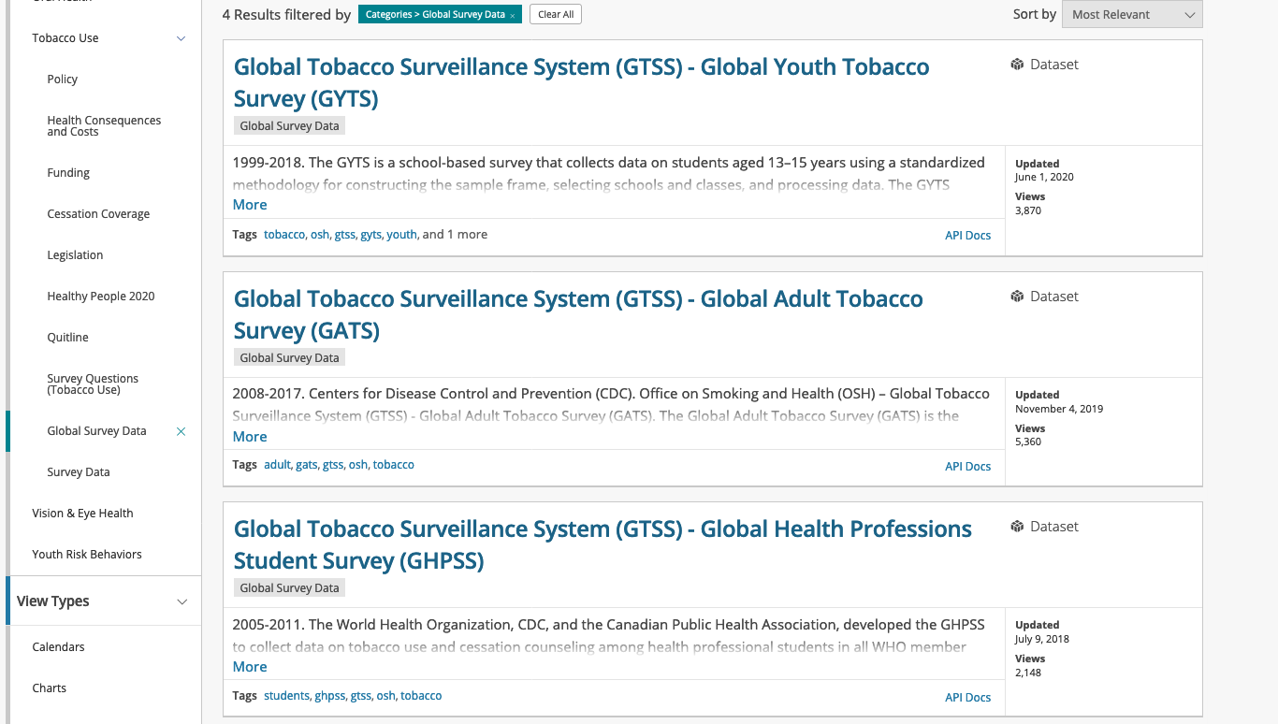

Slide 5
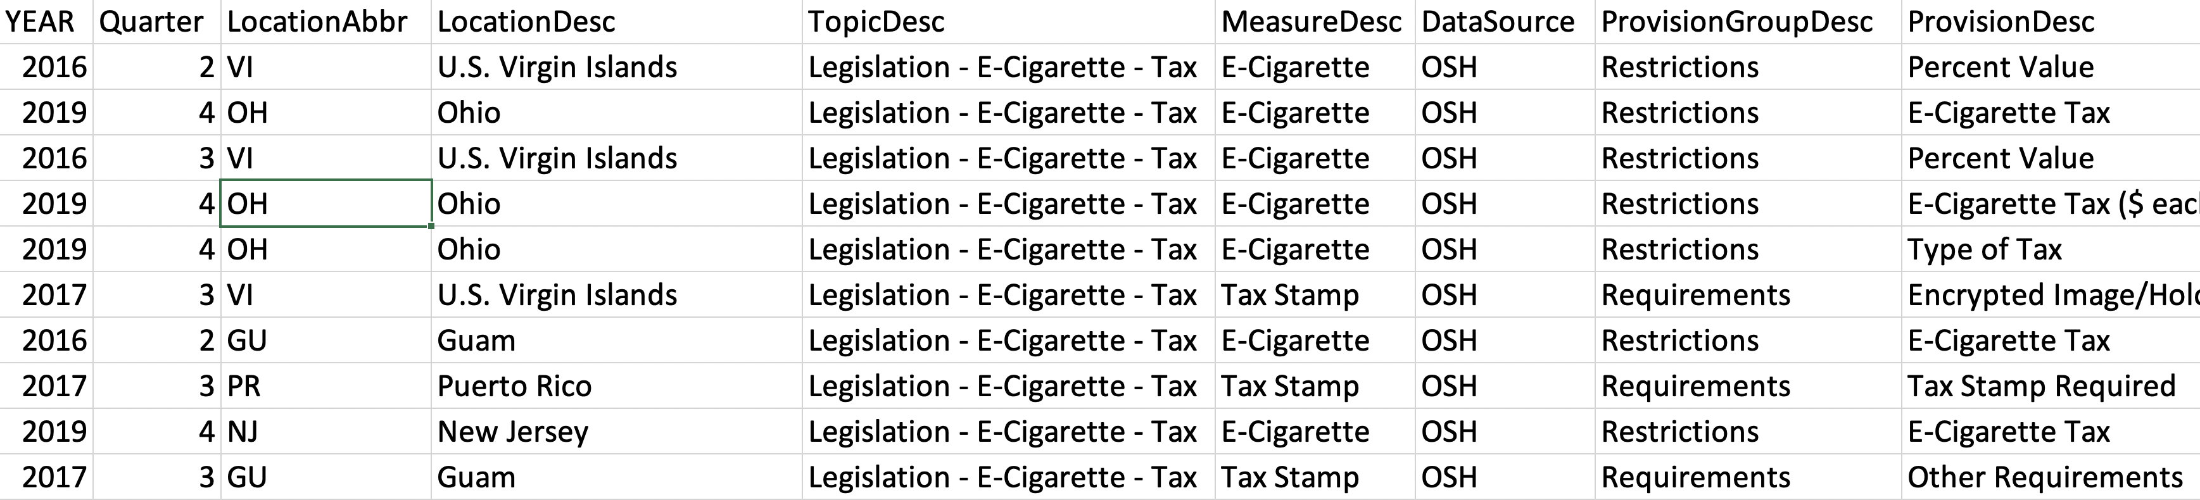

CDC E-Cigarette Legislation by State
State
Type of legislation/regulation
Provisions
Year legislation/regulation were active

Slide 6
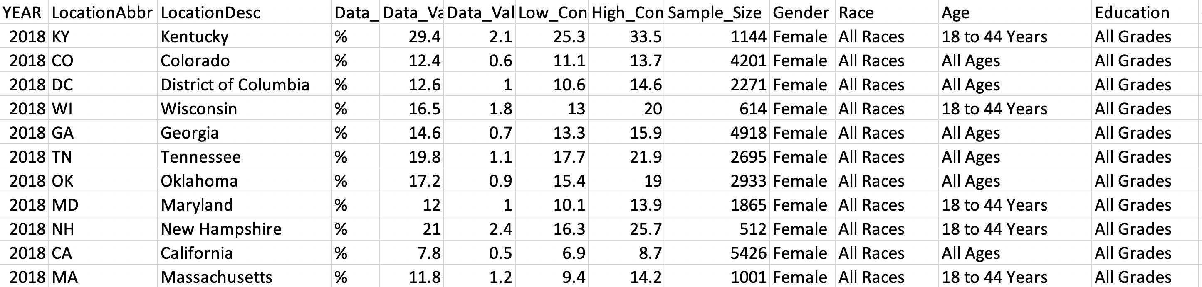
Demographics
State
Age
Race
Method of use

Slide 7
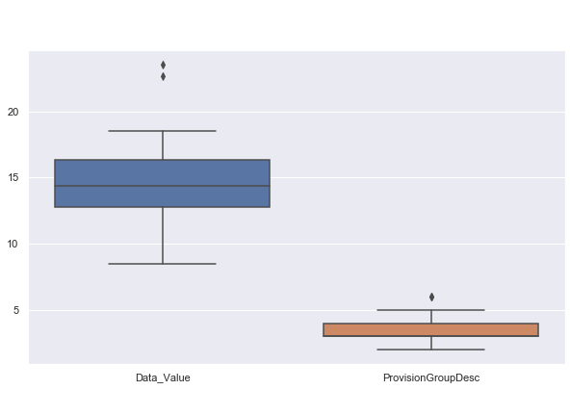
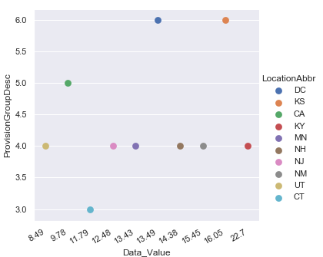
Distribution of Data Sets
Combined Data Sets

Slide 8
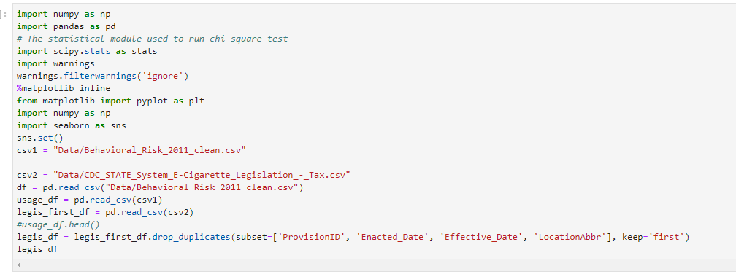
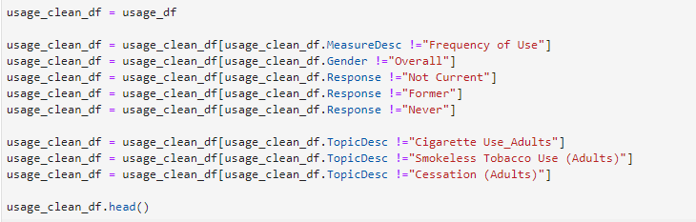
Data Cleanup & Exploration
Topics of Focus
Race
Legislation
% of E-Cig smokers
Tax
Focused by state
Items removed from Data set
Smoking Status not equal to Current
Smoking types not equal to E-Cigarettes
Data sets regarding smoking frequency studies
Legislation duplications from timeframe.

Slide 9
Data Analysis
Planned Analysis : We are going to compare the adult usage rate of the population data to sample data of states with high levels of Anti-E-cigarette legislation to determine statistical significance.
Secondary Analysis : If correlation is determined between high legislation states, then we will determine which forms of legislation are more effective.

Slide 10
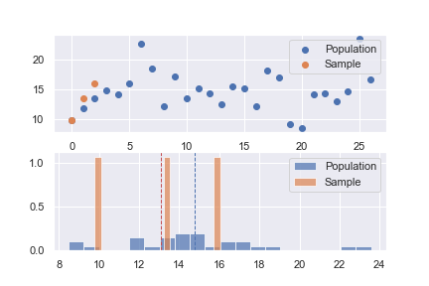
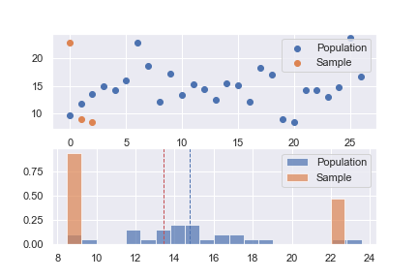
Amount of Legislation vs. Usage Highest Count of Legislation (CA, DC, KS)
Single Stamp Tax vs. Usage
Highest Stamp Price (KY, PR, UT)
T-test Statistic (-0.904) P-Value 0.46
T-test Statistic (-0.286) P-Value 0.80

Slide 11
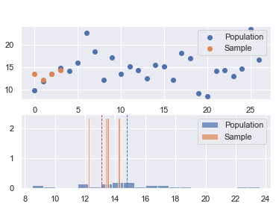
Highest % Tax to E-Cig Unit Price
Highest % Tax to total Unit Price
States observed and Tax % Value
VT 92.0%
MA 75.0%
DC 72.0%
MN 65.0%
Sample Average % Adult use 13.1%
Population Average % Adult use 14.8%
Statistic (-3.187)
P-Value – 0.049
Sufficient evidence to reject null hypothesis that % Tax legislation is not impacting Adult use of E-Cig.
Notes:
jkenjkldvkfkndkfvndflkvnckjvnclvklndfkdlkngdklngdkln

Slide 12
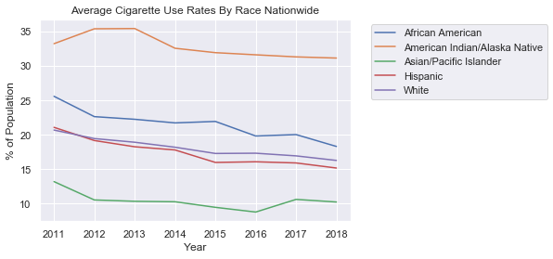
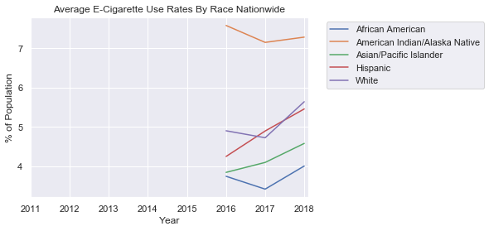
Nation Wide Use of Tobacco By Race

Slide 13
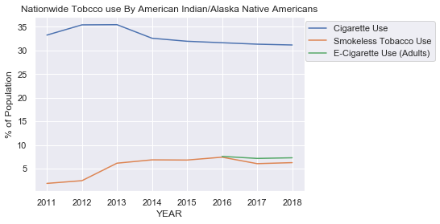
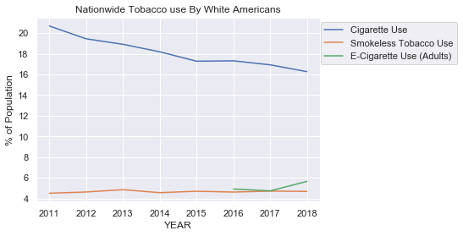
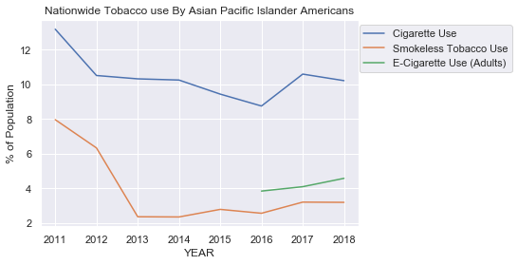
Nation Wide Use of Tobacco By Race

Slide 14
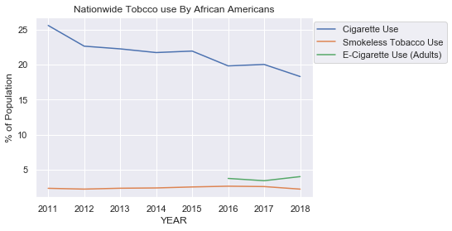
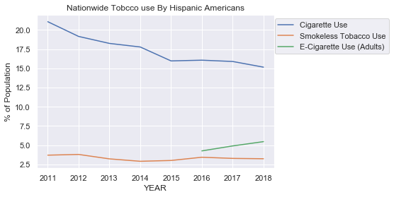
Nation Wide Use of Tobacco By Race

Slide 15
States With The Most Legislation:
California
District of Columbia
Kansas

Slide 16
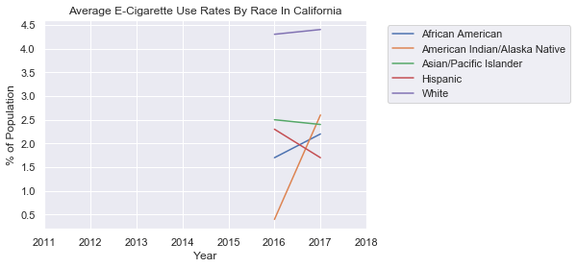
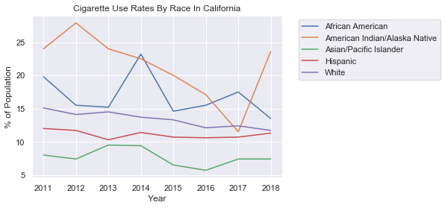
Cigarette vs. E-Cigarette In California

Slide 17
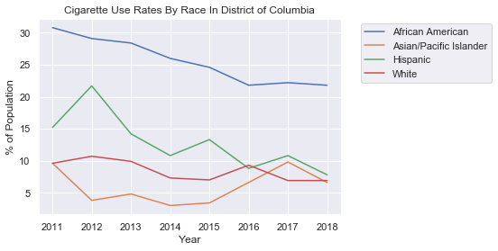
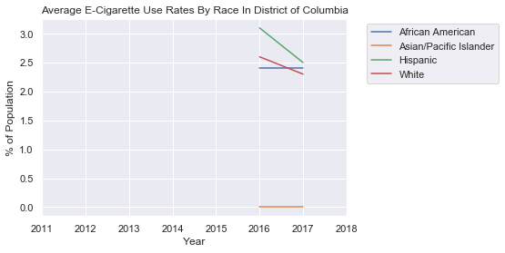
Cigarette vs. E-Cigarette In District of Columbia

Slide 18
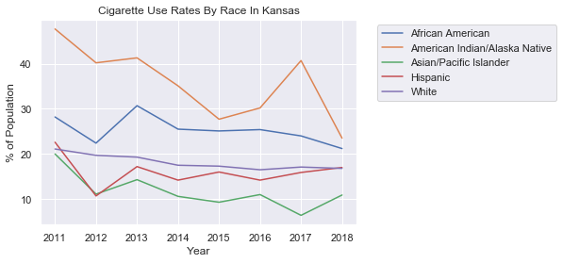
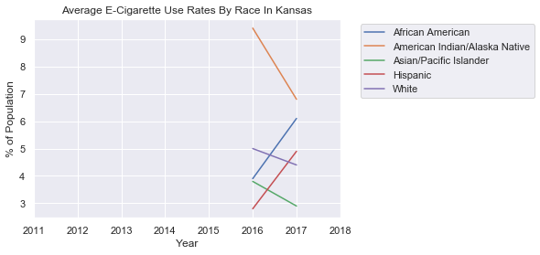
Cigarette vs. E-Cigarette In Kansas

Slide 19
Discussion
States with the most legislation did not show a meaningful reduction amount of e-cigarette smokers.
“How has legislation on E-cigarettes changed smoking habits?”
States with the highest legislation did not produce a P-value to reject the null hypothesis
“Which legislation was most effective?”
Most effective legislation was % to total cost tax
“How did legislation effect smoking habits by demographics?”
There has been a downward trend of cigarette and E-Cigarette use in states with the most legislation, except for American Indians in California, which have a spike in usage.

Slide 20
Post Mortem
The biggest difficulties we had was narrowing down a topic to discuss. We began with the idea of how vaping effected the cigarette industry, and the tobacco industry as a whole. We came to the conclusion to narrow down to the effects of legislation and take it further by breaking it down by race.
If given more allotted time we would have further dove into the effects on age, gender, income, education, and marketing tactics.

Slide 21


Questions?

